Slide 1
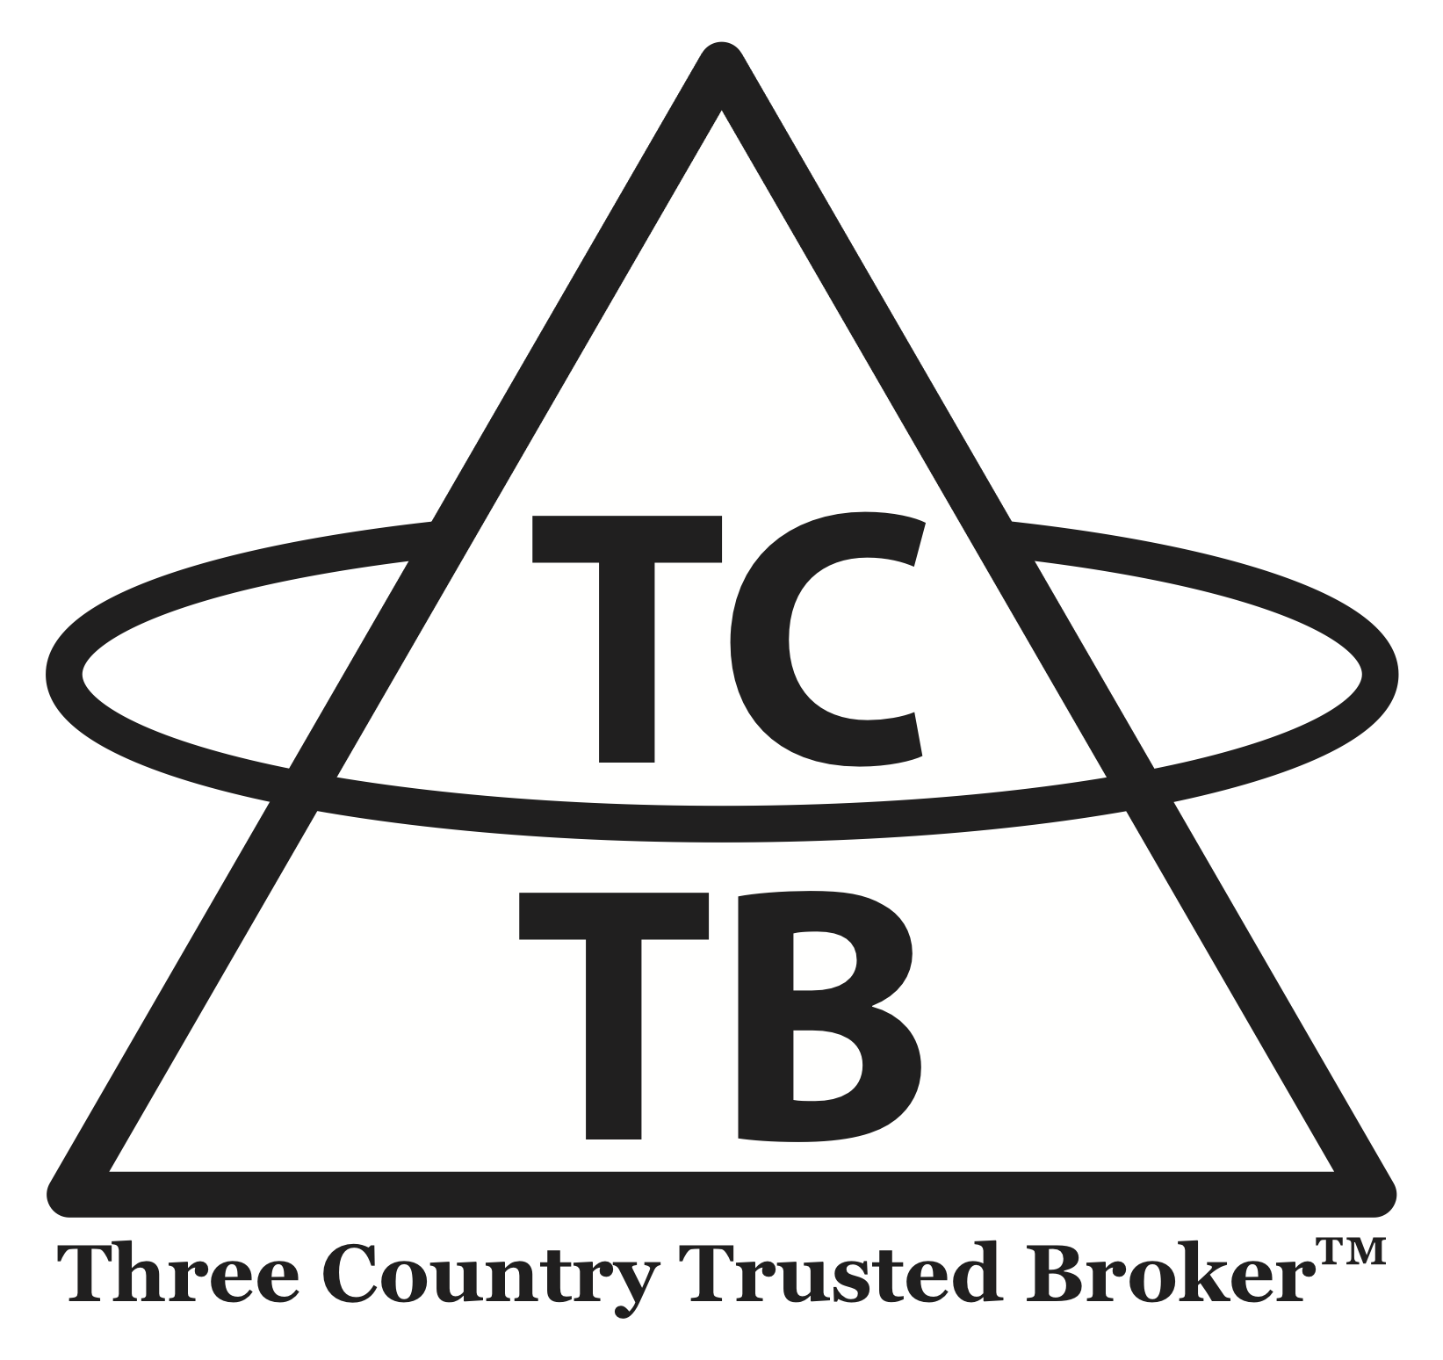
International Institute of Space Law
“Happy Hour” Presentation
September 18, 2021
“TCTB: A Private-Public Path to Cooperative ADR”
Chuck Dickey, Houston, Texas, USA
Valentin Uvarov, Moscow, Russia
TCTB, LLC
threecountrytrustedbroker.com

Slide 2
We All Agree …
Technical consensus some form of active remediation (ADR) is needed NOW to avoid a much more expensive solution later (Kessler Syndrome risk)
Begin with high mass, high collision risk debris in high-LEO (targeting studies are country agnostic)
  Top 50-100 candidates identified
Capable ADR technology emerging across the world (also country agnostic as to targets)
High mass high-LEO debris is a “market” without paying customers
Single country solutions are inherently inefficient – we need to cooperate!
Seven entities are responsible for virtually all debris (Risk)
  Russia, U. S., China own the lion’s share, but most are Russian
  France, Japan, India and ESA have contributed to the problem
The same seven entities use space extensively today, and have the most to gain from ADR (Opportunity)

Slide 3
Hurdles to Cooperative ADR
Legal (no clear solution under existing international law)
Political (will lacking, cooperation today unlikely through traditional diplomatic channels)
National Security (most ADR technology is “dual use”, some debris reflects military secrets)
Economic
  Mismatch between technology (country agnostic) and responsibility (country specific)
  Commercial solutions lack paying customers
  Single country solutions inherently inefficient
Funding required is huge, more than any single country could or should bear alone

Slide 4
ADR Alternatives
ADR (new)
ITU, IMO
IADC
INREMSAT
ICAO
TCTB, LLC
Bilateral+
Do nothing
(dodge)
Unilateral
Private-Public
(NGO)
Public (IGO) (Multilateral)
Public
Cooperative

Slide 5
TCTB: Contracting Relationships

Slide 6
Questions?
threecountrytrustedbroker.com
Chuck Dickey
jcdickey@threecountrytrustedbroker.com
Valentin Uvarov
uvarov.valent@yandex.ru
TCTB, LLC
P. O. Box 591031
Houston, TX 77259

